Slide 1
Cell injury
Changes in cellular structures and function in response to stress.

Slide 2
Causes of cell injury
1. Hypoxia and ischaemia
2. Physical agents( heat and cold ,ultraviolet and truma )
3. Chemical agents and drugs (poisons such as cyanide, arsenic, mercury; strong acids and alkalis and environmental pollutants)
4. Microbial agents caused by bacteria, rickettsiae, viruses, fungi, protozoa and parasite)
5. Immunologic agents ( hypersensitivity reactions; anaphylactic reactions; and autoimmune diseases.
6. Nutritional derangements( starvation and obesity)
7. Aging

Slide 3
Type of cell injury
Reversible changes (degeneration)
Irreversible changes (necrosis or cell death)
Adaptation.
Degeneration :reversal change in which the cell return to normal after remove the stress or causative agents. Ch. By. nucleus is normal.

Slide 4
Type of degeneration
1. cloudy swelling.
2.Hydropic degeneration.
3.Fatty changes.
4.mucoid and myxometuse degeneration.
5.Hayalin degeneration
6. Amyloid degeneration.

Slide 5
Type of degeneration
1. Cloudy swelling results from impaired regulation of sodium and potassium at the level of cell membrane. This results in intracellular accumulation of sodium and escape of potassium. This, in turn, leads to rapid flow of water into the cell to maintain iso-osmotic conditions and hence cellular swelling occurs

Slide 6
2.Hydropic degeneration :Is sever form of cloudy swelling, in which accumulation vacuoles of water in cytoplasm.
Accure in liver.
caused by alcohol, CCL4 toxicity and viral hepatitis.

Slide 7
. Grossly, the affected organ such as kidney, liver, pancreas, or heart muscle is enlarged due to swelling. The cut surface bulges outwards and is slightly opaque.
Microscopically, it is characterised by the following features (Fig. 3.11): i) The cells are swollen and the microvasculature compressed. ii) Small clear vacuoles are seen in the cells and hence the term vacuolar degeneration. These vacuoles represent distended cisternae of the endoplasmic reticulum. iii) Small cytoplasmic blebs may be seen. iv) The nucleus may appear pale.

Slide 9
3.fatty change (steatosis)
Is abnormal accumulation of fat in cytoplasm of cell. It is especially common in the liver but may occur in other non-fatty tissues like the heart, skeletal muscle, kidneys (lipoid nephrosis or minimum change disease) and other organs.

Slide 10
Causes of fatty changes
1.increase fatty acid.(obesity.starvation)
2.increase fatty acid synthesis in the liver
3.decrease oxidation fatty acid (hipoxia and anemia)
4.increase esterification of fatty acid to triglycerides( as alcoholsim)
5.decrese synthesis of apoprotin (mal nutrition and alcohol or toxicity)

Slide 11
sings
Grossly..
Liver enlarged
Soft with round borders.
Yellow in color.
Greasy to touch
Microscopically..
Liver cell accumulate fat which appear in H andE stained.as clear vacules.
These vacules small and then fuse toform large vacules which push the nucleuse to one side of cell .signet ring cell.

Slide 12
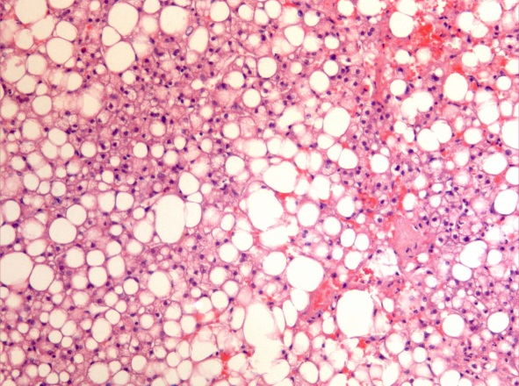
Fatty changes _

Slide 13
4.Mucinous and myxomatous degeneration
Normally.: Mucin secreted by mucous cell of mucous glands.(respiratory tract and GIT)
Mucin, a glycoprotein, is its chief constituent. Mucin is normally produced by epithelial cells of mucous membranes and mucous glands, as well as by some connective tissues like in the umbilical cord. By convention, connective tissue mucin is termed myxoid (mucus like). Both types of mucin

Slide 14
Groslly..
Pale grey transparent slimy fluid.
Microscopically..
Pale blue stain with Hand E staining.
CT/(myxomatous)
Few star shape with processes seprated by blue mucin with round hyperchromatic nucli.
Cytoplasim is pale.

Slide 15
Mucoid degeneration

Slide 16
sites
1.Epithelial (mucoid) :Catarrhal inflammation of mucous membrane (e.g. of respiratory tract, alimentary tract, uterus). 2. Obstruction of duct leading to mucocele in the oral cavity and gallbladder.
2.C T/(myxomatous) present in:
In sub cutaneous tissue of myxoma and C T of tumer.

Slide 17
5. Hyaline degeneration
means deposition glassy, homogeneous, eosinophilic protein material either inside cell or in connective tissue.
A:Cellular haylinosis:
1,mallary…..liver of chronic alchoholism
2.corpora amylaca…..prostate of old male
3.russel bodies……plasma cell in scleroma.

Slide 18
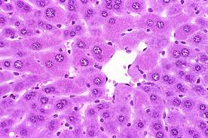
Hyalin degeneration

Slide 19
B: connective tissue hyalenosis
1. wall of blood vessel.
2. old scar, thrombi and tumers.

Slide 20
6.Amyloidosis
Amyloidsis is condtion in which theres depostion of abnormal extra cellular fibrillar protein( amyloid) in many tissue.
In general amyloid present near basement membrane of blood vessels.

Slide 21
Grossly: appear brown with iodin and become blue with add selphoric acid
Microscopically..
Appear eosinophilic with H and E stain.
Amyloid stain red by congo red
It also demonstrate by metachromatic stain (genten ,methyl, And crystal violet)

Slide 22
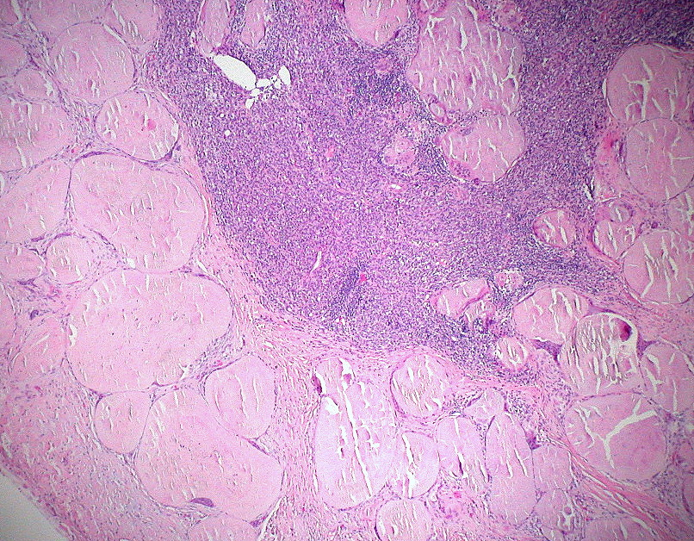
Amyloidosis

